Slide 1
Lists, Stacks, and Queues
Notes:
Introduction
Welcome to COP 4530, Data Structures, Algorithms, and Generic Programming. I hope very much, and sincerely believe, that this course will change you in ways that are deeply satisfying. So far, you have acquired proficiency in programming. This course will start the process of your transformation from a programmer to a computer scientist. One of the important tasks of a computer scientist is to make efficient use of computational resources. This course will teach you about different ways of organizing the data to facilitate such efficient use, and will also discuss efficient techniques to perform some fundamental operations in computer science. A subsequent course on Algorithms, COP 4531, will teach you to use the techniques discussed in this course to solve commonly encountered computer science problems efficiently. Both these courses will also teach you to analyze the efficiency, and prove the correctness, of your program in a mathematically rigorous manner. Material you learn in these two courses is critical to your becoming a good software developer later.

Slide 2
List Wish List
Insert an element
Remove an element
Remove all items
Assignment operator
Comparison operators
Constructors/destructors
Generic class
Convenient way to iterate through the list

Slide 3
Abstract view of List and Iterator
ListElement
next
next
next
next
null
null
prev
prev
prev
prev
front
I1
back
Iterator

Slide 4
List Public Interface
Read-only accessor functions
  int size() const;
  bool empty() const;

Slide 5
List Public Interface (contd)
Locating places on the list
  iterator begin();
  const iterator begin() const;
  iterator end();
  const iterator end() const;
Accessing values on the list
  Object & front();
  Object & back();
  (and their const versions)

Slide 6
List Public Interface (contd.)
Write functions
  void push_front(const Object & x);
  void push_back(const Object & x);
  void pop_front();
  void pop_back();
  iterator insert(iterator & itr, const Object & x);
  iterator erase( iterator itr);
  iterator erase( iterator start, iterator end );
  void clear();

Slide 7
List Public Interface (contd.)
Constructors and destructor
  List();
  List(const List & rhs);
  ~List();

Slide 8
List Complexity Requirements
O(1) Runtime complexity
  Default Constructor
  push_front(t), push_back(t), insert(I, t)
  pop_front(), pop_back(), erase(I)
  begin(), end();
  front(), back();
  empty();

Slide 9
List Complexity Requirements (2)
O(N) Runtime complexity
  Copy Constructor
  Destructor
  clear()
  erase(SI,EI)

Slide 10
List Iterator Public Interface
Read-only operators
  int operator== (const iterator & rhs) const;
  int operator!= (const iterator & rhs) const;
  Object& operator* ( ) const; // return a reference to // current value
Write operators
  iterator& operator++ ( ); // prefix
  iterator operator++ ( int ); // postfix
  iterator& operator-- ( ); // prefix
  iterator operator-- ( int ); // postfix
O(1) requirement for space and time

Slide 11
Using List
List<String> TopColleges;
TopColleges.push_front(“Yale”);
  “Yale”
TopColleges.push_back(“MIT”);
  “Yale”, “MIT”
TopColleges.push_front(“Havard”);
  “Havard”, “Yale”, “MIT”
TopColleges.push_back(“UMich”);
  “Havard”, “Yale”, “MIT”, “UMich”
List<String>::iterator I;
for (I = TopColleges.begin(); I != TopColleges.end(); I++) {
// print list with <<
}

Slide 12
List Insertion
Insert “UM-Dearborn” before “Yale”
// sequential search
for (I = TopColleges.begin(); I != TopColleges.end(); I++) {
if (“Yale” == *I) {
break;
}
}
// insert the new string
TopColleges.insert(I, “UM-Dearborn”);
  “Havard”, “UM-Dearborn”, “Yale”, “MIT”, “UMich”
// what happens if “Yale” is not on the list?

Slide 13
Remove all copies of an item from List
List<String>::iterator I = TopColleges.begin();
while( I != TopColleges.end()) {
if (“UMich” == *I) {
TopColleges.erase(I);
} else {
I++;
}
}

Slide 14
List and List Iterator
  Conceptual relationship
    Iterator I1
    begin current end
    List: A, B, C, D, E, F
    begin current end
    Iterator I2

Slide 15
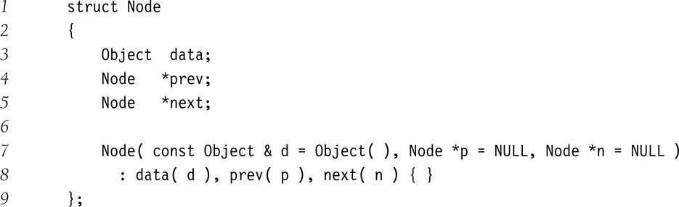
Nodes in a list
Node
  Pointers to the previous and next element
  Data Value
Defined within the List class, with limited scope
data
prev
next
data
prev
next
data
prev
next
No need for contiguous memory allocation

Slide 16
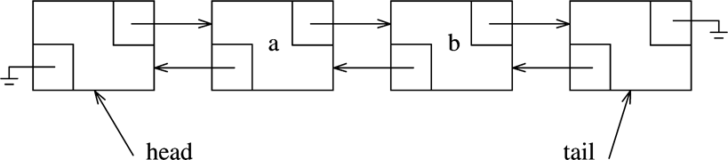
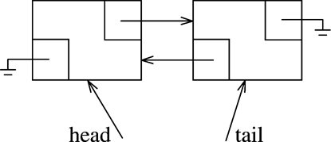
List Implementation
A Doubly Linked List With Header and Tail Nodes as Markers
An Empty List

Slide 17
Stack ADT
Collections:
  Elements of some proper type T
Operations:
  void push(T t)
  void pop()
  T top()
  bool empty()
  unsigned int size()
  constructor and destructor

Slide 18
Uses of ADT Stack
Depth first search / backtracking
Evaluating postfix expressions
Converting infix to postfix
Function calls (runtime stack)
Recursion

Slide 19
Queue ADT - FIFO
Collection
  Elements of some proper type T
Operations
  void push(T t)
  void pop()
  T front()
  bool empty()
  unsigned int size()
  Constructors and destructors

Slide 20
Uses of ADT Queue
Buffers
Breadth first search
Simulations
Producer-Consumer Problems

